Slide 1
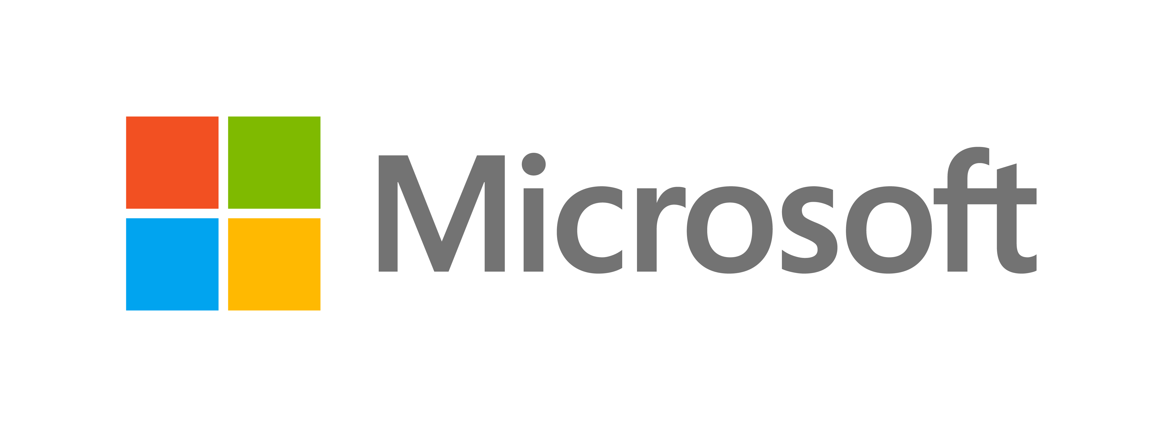
Microsoft and the Evolution of Windows: A Story of Innovation

Slide 2





TEAM INTRODUCTION
JEREMY SAMUEL
NIKHIL CHANDRA KATTA
JAGRUTHI KOMMIDI
VIKAS RAO
SOUMYATA BINANI

Slide 3

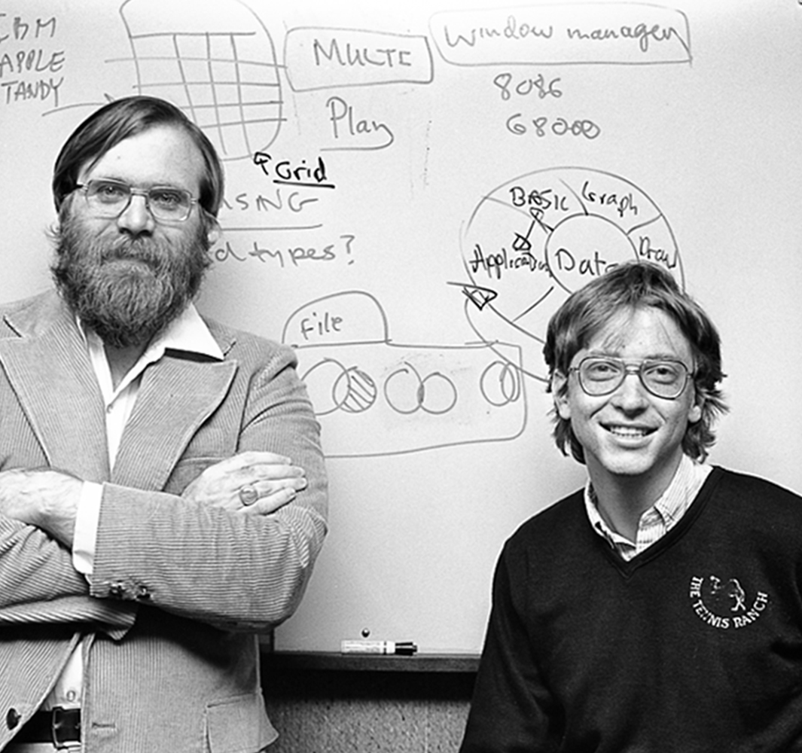
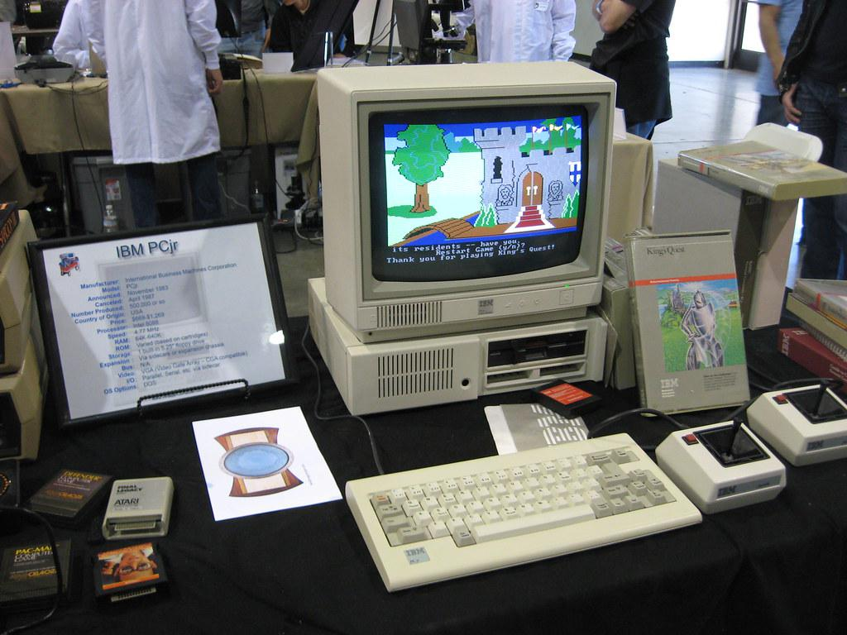
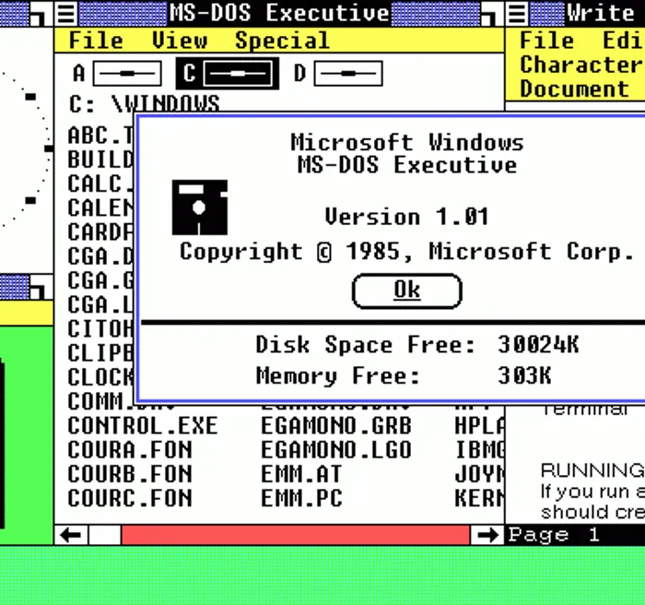
1975
1980
1985
Microsoft founded in a small garage.
First success: BASIC interpreter for Altair 8800.
Vision: Bring computers into homes, schools, and businesses.
IBM turns to Microsoft for an OS.
MS-DOS licensed broadly, fueling the PC boom.
Revolutionary licensing model gave Microsoft a competitive edge.
Windows 1.0 launched—GUI built on MS-DOS.
Bridged the gap between complex Unix/Linux and costly Apple.
Affordable, versatile.

Slide 4
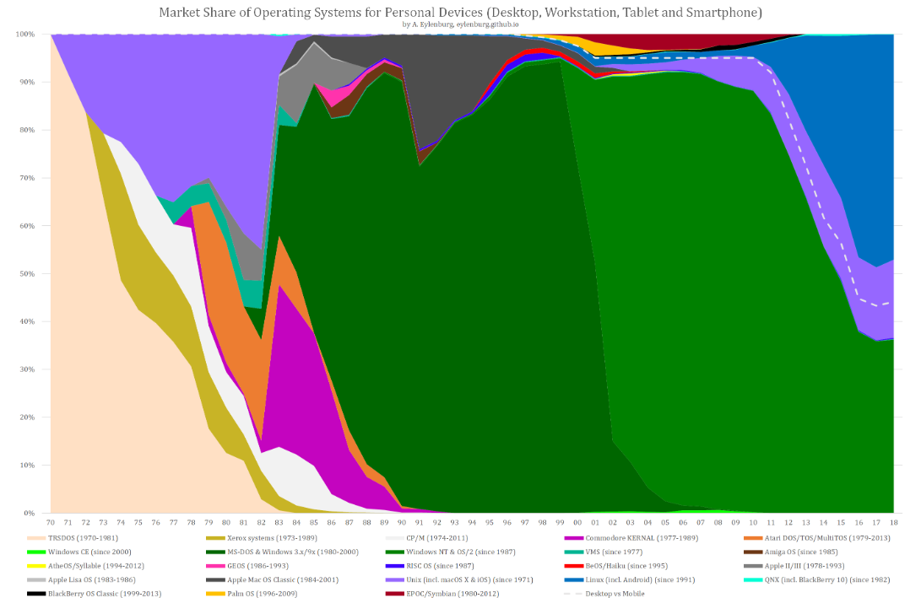
Windows 7
- Best Stable version - Improved performance
Age of Ferment
Dominant Design
Age of Incremental Change
700
600
500
400
300
200
100
Windows 11
- Improved security, snap layouts
Windows 2000 and XP
- Best Windows version - Security Issues
Windows 10
- Cortana - Return of Start Menu
Windows 3.0 and 3.1
- Challenger to other OS - Better colors and multitasking
MS DOS
- Command line OS - IBM PCs
Sales in millions
Windows 8 and 8.1
- Modern UI - Removed start menu - Mixed reception - Added start option in 8.1
Windows 1.0 and 2.0
- GUI on top of MS-DOS - Multitasking
Demand for OS starts – Unix, CP/M comes up
Windows Vista
- Performance issues
Windows 95
- Start Menu - Internet Explore
Windows
MS DOS
1975 1980 1985 1990 1995 2000 2005 2010 2015 2020 2025 Years

Slide 5
Windows 11 will continue to grow, potentially becoming the dominant Windows OS by early 2025. Windows 11 has reached a 35% market share as of October 2024, up from 28% at the beginning of the year.
Windows 10 will enter the Decline phase as support ends on October 14, 2025. After this date, Microsoft will no longer provide free security updates, feature updates, or technical support for Windows 10. This transition may lead to market share redistribution as some users might migrate to competing operating systems (Apple, Linux etc.) rather than upgrading to Windows 11.
The next Windows iteration may enter the Innovation phase within the next 2-3 years. Windows 12 is expected to be released in Fall 2025, based on Microsoft's typical release cycles. This timeline coincides with Apple's anticipated release of macOS Sequoia with Apple Intelligence.
Future Windows versions will focus on AI integration and improved cross-platform functionality. AI capabilities are anticipated to be a major focus in Windows 12, building on the AI features introduced in Windows 11 updates.
PREDICTIONS

Slide 6
Windows 11 will continue to grow, potentially becoming the dominant Windows OS by early 2025. Windows 11 has reached a 35% market share as of October 2024, up from 28% at the beginning of the year.
Windows 10 will enter the Decline phase as support ends on October 14, 2025. After this date, Microsoft will no longer provide free security updates, feature updates, or technical support for Windows 10. This transition may lead to market share redistribution as some users might migrate to competing operating systems (Apple, Linux etc.) rather than upgrading to Windows 11.
The next Windows iteration may enter the Innovation phase within the next 2-3 years. Windows 12 is expected to be released in Fall 2025, based on Microsoft's typical release cycles. This timeline coincides with Apple's anticipated release of macOS Sequoia with Apple Intelligence.
Future Windows versions will focus on AI integration and improved cross-platform functionality. AI capabilities are anticipated to be a major focus in Windows 12, building on the AI features introduced in Windows 11 updates.

Slide 7
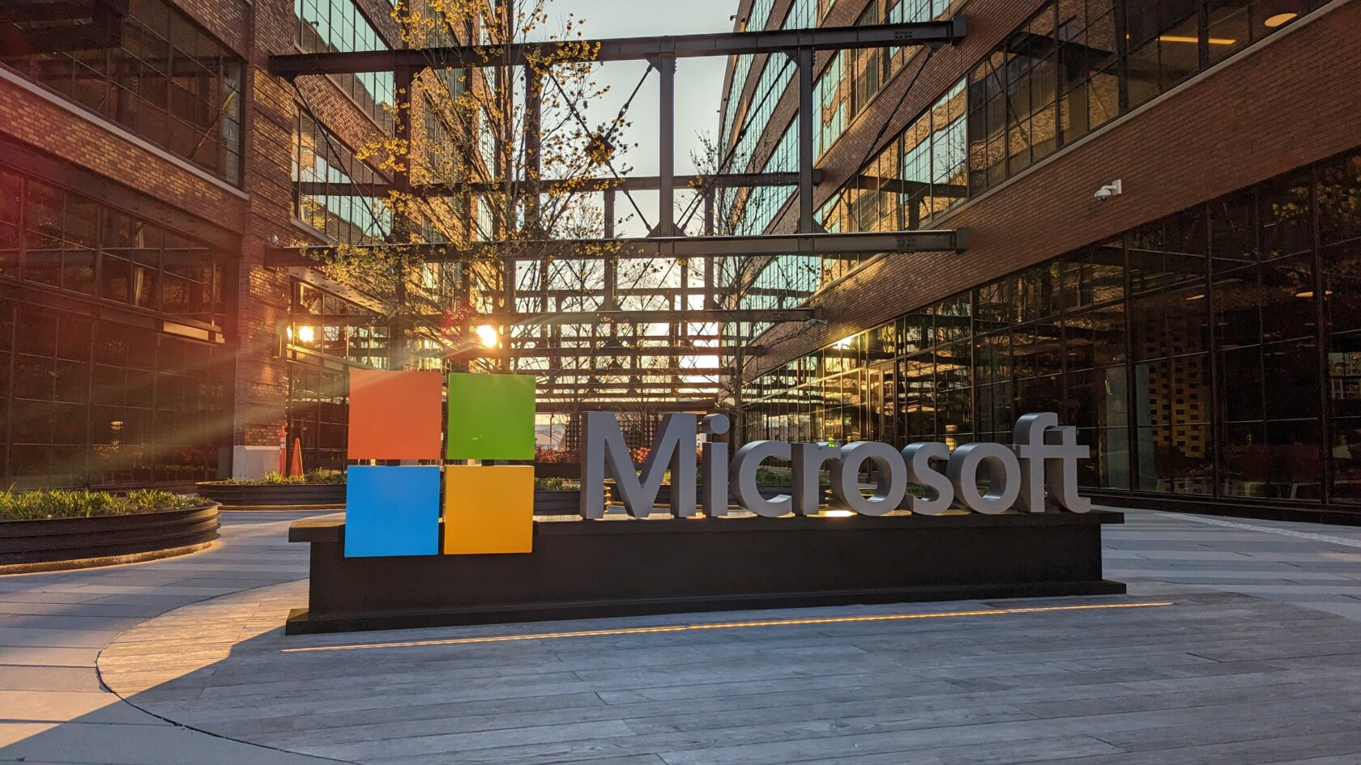
Simplify migration to Windows 11 with user-friendly guides and enterprise-focused upgrade packages.
Clearly communicate Windows 10's end-of-support deadlines and provide extended support for critical industries.
Prioritize AI integration and cross-platform compatibility in future Windows versions.
Highlight the security benefits of upgrading from legacy systems while offering bundled upgrade deals.
Develop a modular OS design with tailored features and deeper hybrid cloud integration.
Ensure app compatibility and drive ecosystem growth with developer-friendly tools like GitHub Copilot.

Slide 8
Simplify migration to Windows 11 with user-friendly guides and enterprise-focused upgrade packages.
Clearly communicate Windows 10's end-of-support deadlines and provide extended support for critical industries.
Prioritize AI integration and cross-platform compatibility in future Windows versions.
Highlight the security benefits of upgrading from legacy systems while offering bundled upgrade deals.
Develop a modular OS design with tailored features and deeper hybrid cloud integration.
Ensure app compatibility and drive ecosystem growth with developer-friendly tools like GitHub Copilot.

Slide 9
REFERENCES
Microsoft. (n.d.). Microsoft history: Founding and early years. Retrieved from https://www.microsoft.com/about/history
Eylenburg. (n.d.). OS market share. Retrieved from https://eylenburg.github.io/os_marketshare.htm
1E. (n.d.). The evolution of Windows. Retrieved from https://www.1e.com/evolution-of-windows/index.html#windows2007
Han, L. (2023). Why I’m buying Microsoft (MSFT). Retrieved from https://lawrencehan94.medium.com/why-im-buying-microsoft-msft-ab08ebf91f8e
WindowsForum. (2023). Windows 11 market share: Growth challenges and future outlook. Retrieved from https://windowsforum.com/threads/windows-11-market-share-hits-35-growth-challenges-and-future-outlook.344746/
Computer City. (n.d.). Windows 11 market share. Retrieved from https://computercity.com/software/windows/windows-11-market-share
Windows Developer Blog. (2023). Bringing the power of AI to Windows 11: Unlocking a new era of productivity for customers and developers with Windows Copilot and Dev Home. Retrieved from https://blogs.windows.com/windowsdeveloper/2023/05/23/bringing-the-power-of-ai-to-windows-11-unlocking-a-new-era-of-productivity-for-customers-and-developers-with-windows-copilot-and-dev-home/
PCMag. (n.d.). A visual history of Windows. Retrieved from https://www.pcmag.com/news/a-visual-history-of-windows
PCMag. (n.d.). The rise of DOS: How Microsoft got the IBM PC OS contract. Retrieved from https://www.pcmag.com/news/the-rise-of-dos-how-microsoft-got-the-ibm-pc-os-contract

Slide 10

Q&A

